Slide 1
From Monolith to Microservice
A review of the transition process
Espen Lever

Slide 2
Introduction
With cloud hosting becoming more popular, microservices have become increasingly popular and important.
This essay investigates the migration from a monolithic architecture to a microservice architecture

Slide 3
Research Questions
RQ1: What challenges typically arise when migrating from a monolithic architecture to a microservices-based architecture?
RQ2: What are the key benefits associated with transitioning from monolithic to microservices architecture?
RQ3: Specifically exploring Kubernetes, how does it contribute to orchestrating and managing microservices during the migration process?

Slide 4
Background - Monolithic vs Microservice
Monolithic Architecture
  A product or solution deployed as a single unit.
  Usually consists of a frontend, backend and database
Microservice Architecture
  The product is split into smaller services consisting of isolated features
  Every service has their own database, they share a frontend and communicate with each other through HTTP/REST API

Slide 5
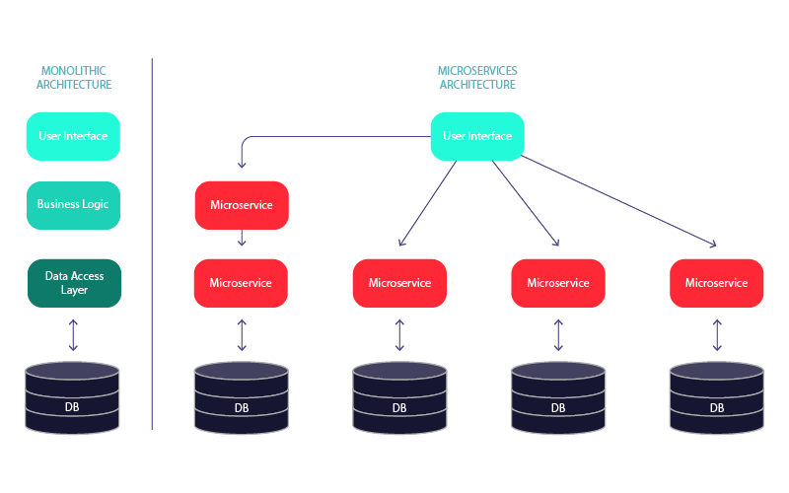
Background - Monolithic vs Microservice

Slide 6
Background - Kubernetes
Kubernetes is a container orchestration platform created by Google in 2014
Very popular for managing microservices in the form of containers
High compatibility with cloud hosting

Slide 7
Methodology
Literary Review:
  Main literature: Monolith to Microservices: Evolutionary Patterns to Transform Your Monolith by Sam Newman
Survey:
  Targeting people who experienced a migration process
  Distributed on Reddit (r/devops, r/kubernetes), Kubernetes Community Forum and Oracle Developer Forum

Slide 8
Result - Challenges in Migrating
Technical Challenges:
  Refactoring an existing codebase
  Design a business domain
  Setting clear boundaries between services
  Splitting a database
Organizational Challenges:
  Educating your teams
  Restructuring properly (Conway’s Law)
  Communication throughout the process

Slide 9
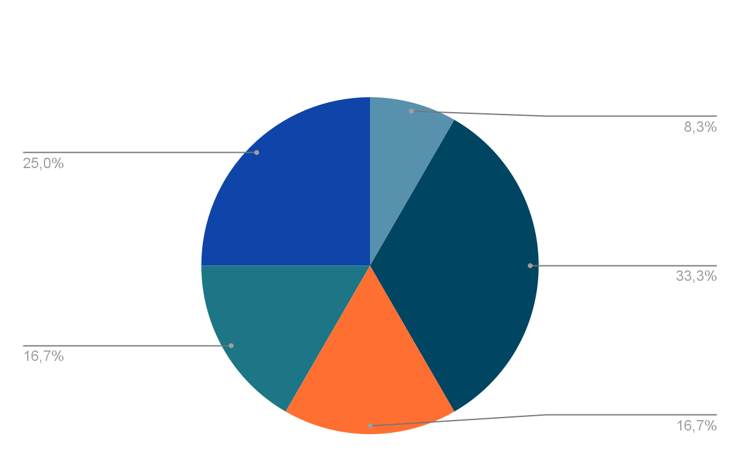
Result - Challenges in Migrating

Slide 10
Result - Benefits of Migrating
Improved team autonomy
Reduced time to market
More cost-effective scaling
Reduced downtime

Slide 11
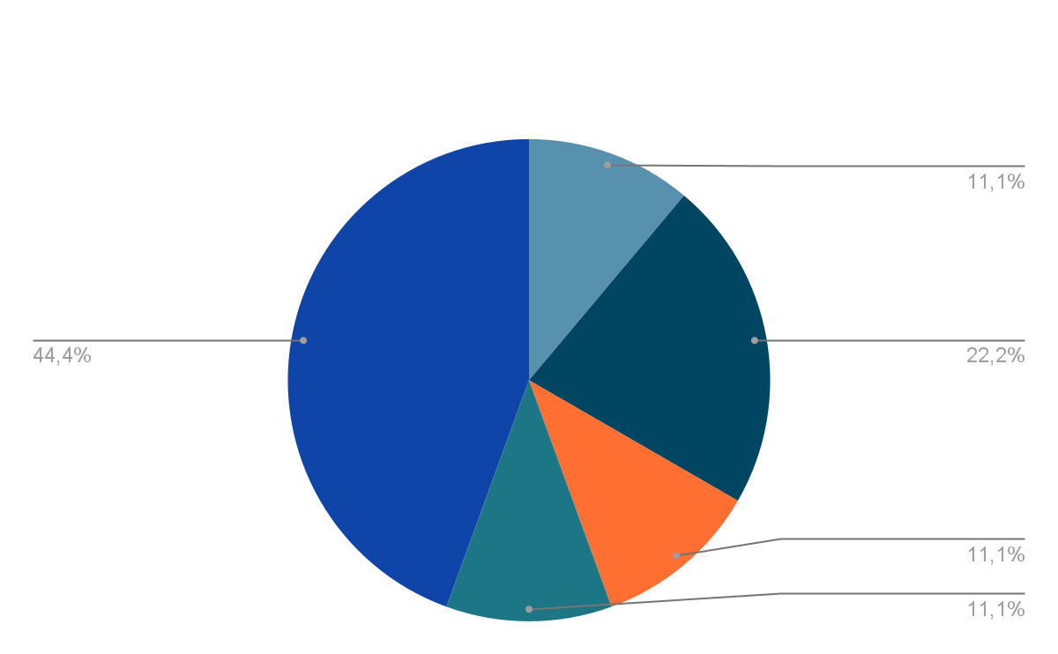
Result - Benefits of Migrating

Slide 12
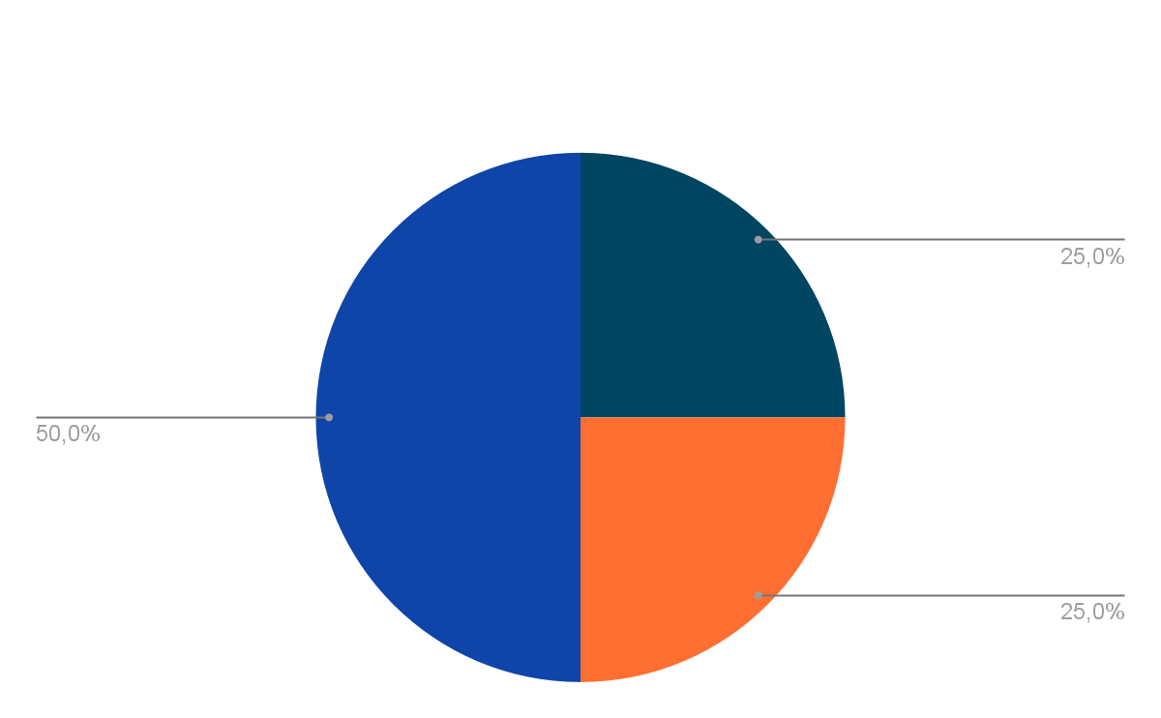
Result - Kubernetes as a Migration Tool

Slide 13
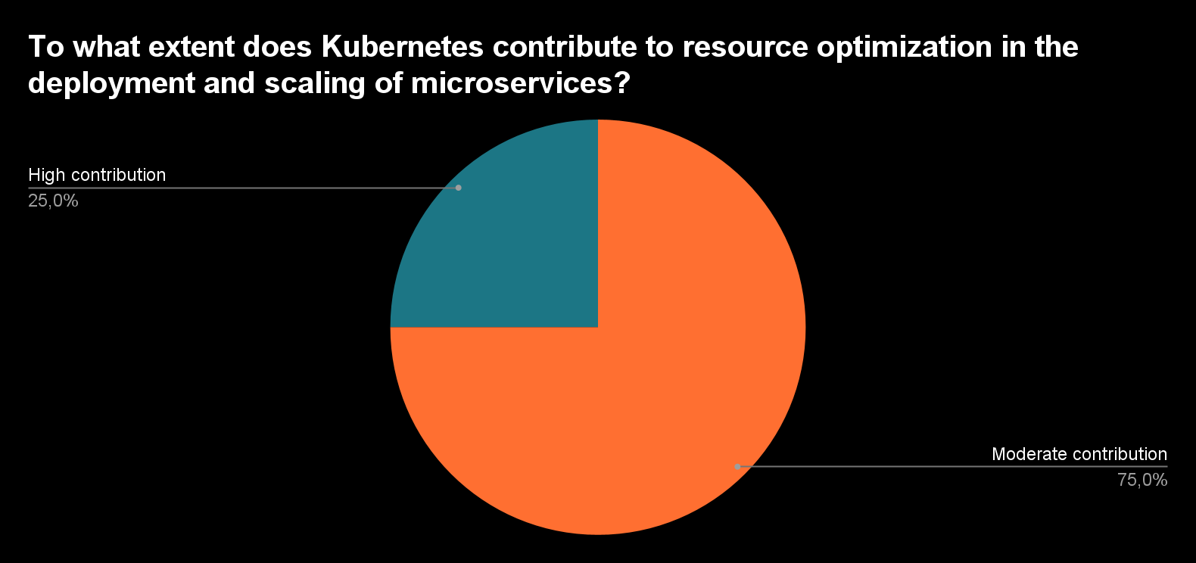
Result - Kubernetes as a Migration Tool

Slide 14
Result - Kubernetes as a Migration Tool
Kubernetes has many features that help overcome challenges or emphasize benefits
  Scaling
  Self-healing
  Networking
  Updates and Rollbacks

Slide 15
Conclusion
Literature and practical data are showing similar challenges and benefits when it comes to the migration process.
Practice put a heavier emphasis on the organizational challenges and benefits of microservice architecture
Kubernetes is shown to make a significant impact when working with microservices.

